Slide 1
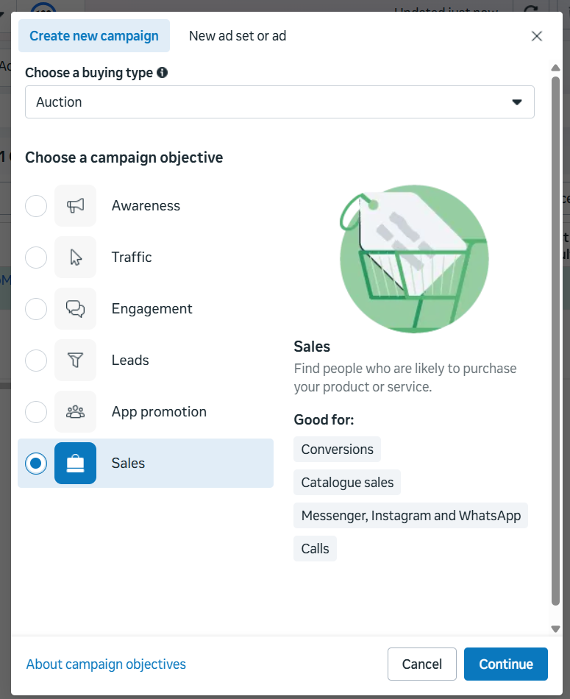
Meta Ads Campaign Setup for JioMart
1. Campaign Objective
Objective: Sales (Catalogue Sales)
Justification
The primary goal of JioMart is to sell products online. Therefore, the Sales objective in Meta Ads is the most suitable because:
It focuses on driving purchases directly from the catalogue
It uses Meta Pixel data to optimize conversions
Shows dynamic ads based on user interests
Retargets users who viewed or added products to cart
Catalogue ads automatically display relevant products to the right audience, increasing the chances of purchase.

Slide 2
Performance Goal, Location & Budget
Budget
Daily Budget: ₹5000
Performance Goal
Goal: Website Purchases
Optimization Event: Purchase
Reason
Optimizing for purchase ensures Meta’s algorithm finds users most likely to complete a transaction rather than just clicking the ad.
Location Targeting
Target Cities:
Mumbai, Delhi, Bangalore, Hyderabad, Pune, Chennai
Justification
These cities:
Have high online shopping penetration
Strong logistics and delivery network
Ad Set | Audience | Budget
Ad Set 1 | Online Grocery Shoppers | ₹1500
Ad Set 2 | Discount & Deal Seekers | ₹1000
Ad Set 3 | Household & Family Audience | ₹1500
Justification
Higher budget allocated to high purchase intent audiences
Retargeting requires lower budget but gives high conversion rates

Slide 3
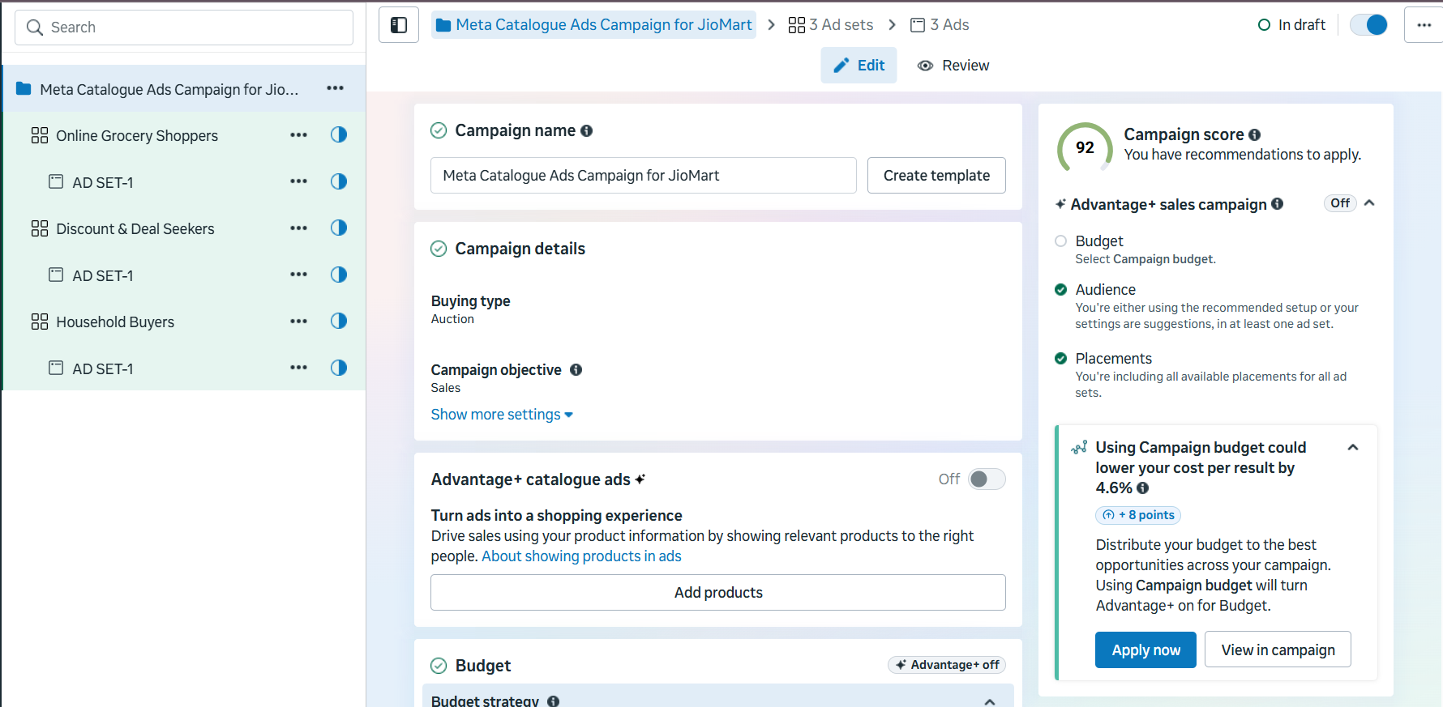
Campaign Outlook

Slide 4
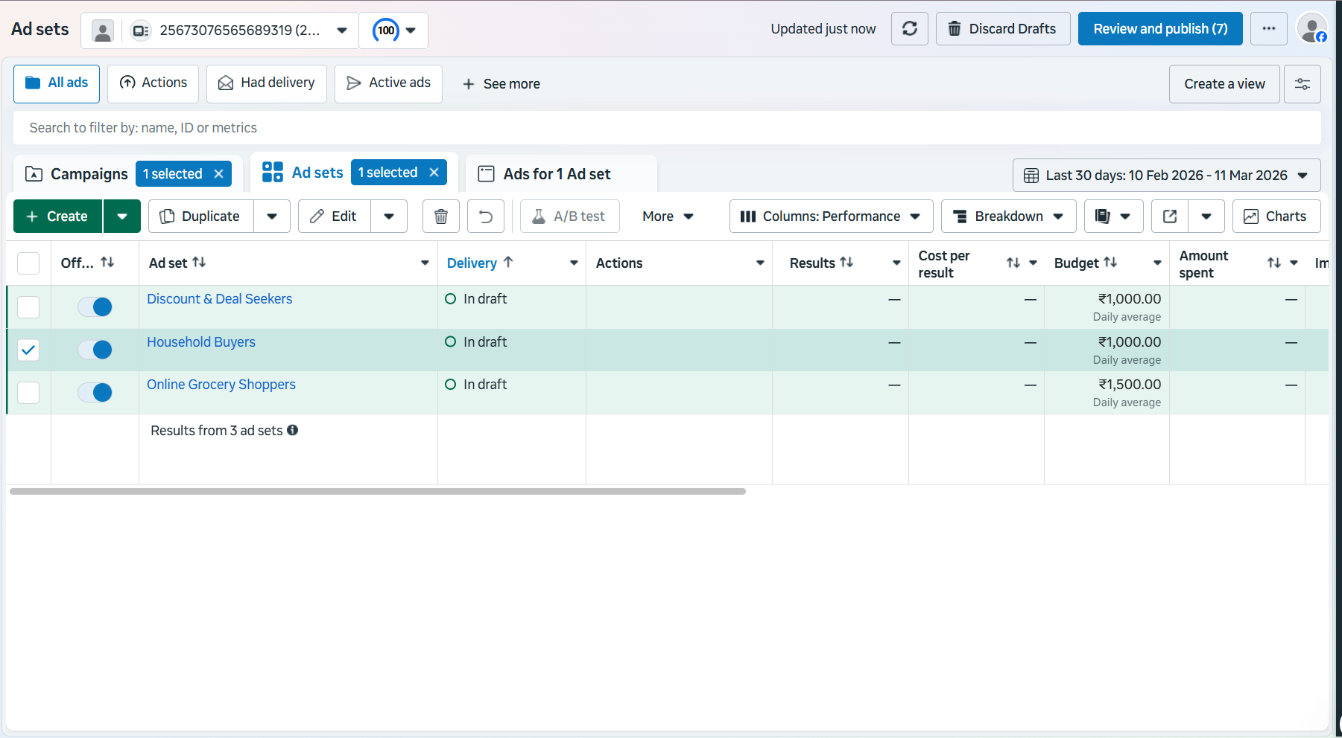
3 AD Sets With Multiple Creative

Slide 5
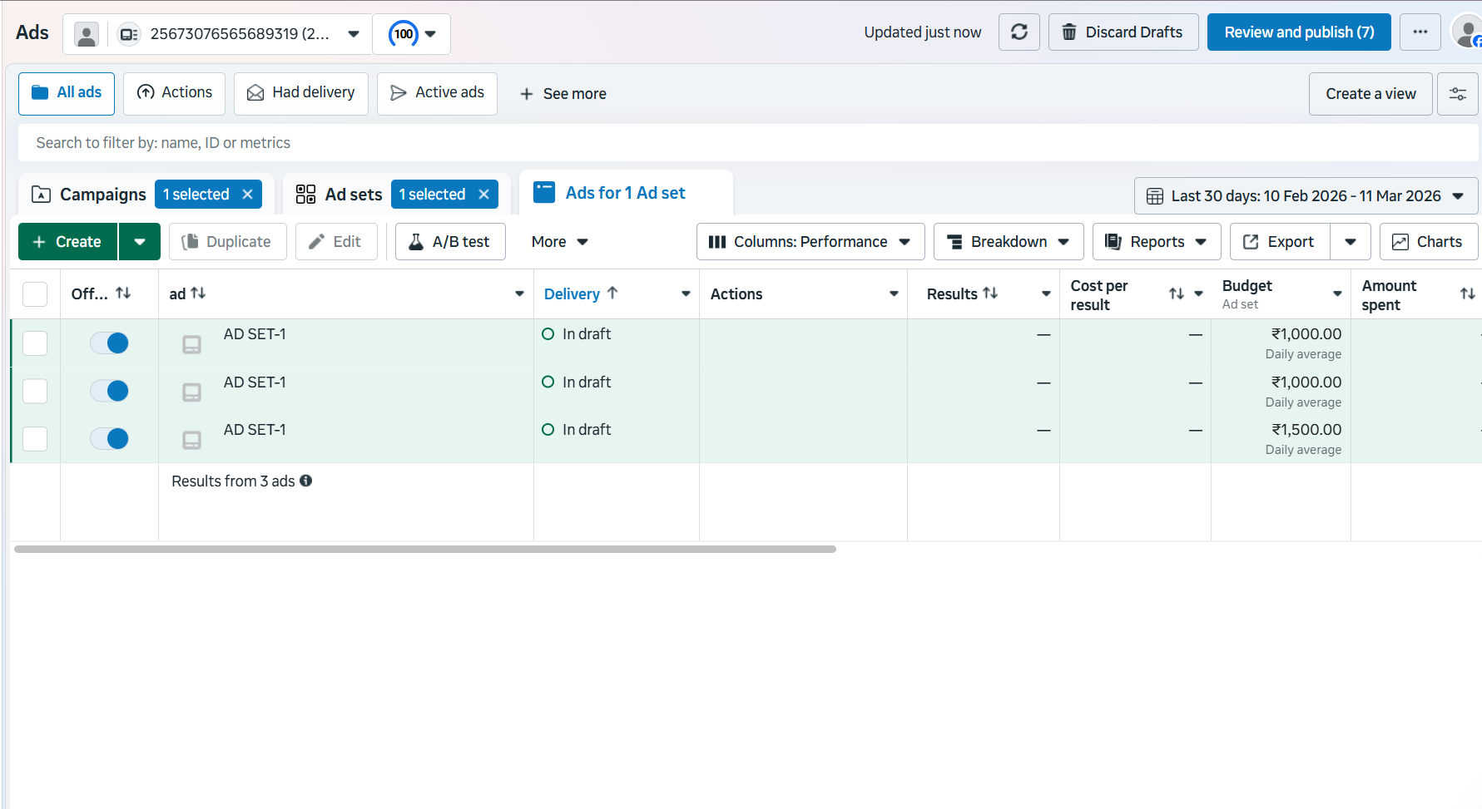

Slide 6
Age & Gender
Age Range: 23 – 50 years
Gender: All
Justification
18–65+ is the main online shopping age group
Both men and women purchase groceries online
Family buyers fall in this range
Catalogue Design (Example Products)
Product | Category | Price
Aashirvaad Atta 5kg | Grocery | ₹275
Tata Salt 1kg | Grocery | ₹28
Fortune Sunflower Oil 1L | Cooking Oil | ₹140
Surf Excel Detergent 1kg | Household | ₹230
Maggi Noodles Pack | Food | ₹60
Amul Butter 500g | Dairy | ₹280
Parle-G Biscuits | Snacks | ₹25
Colgate Toothpaste | Personal Care | ₹120
Good Day Cookies | Snacks | ₹35

Slide 7
